Slide 1
Preschool Fun!!
2024-25

Slide 2
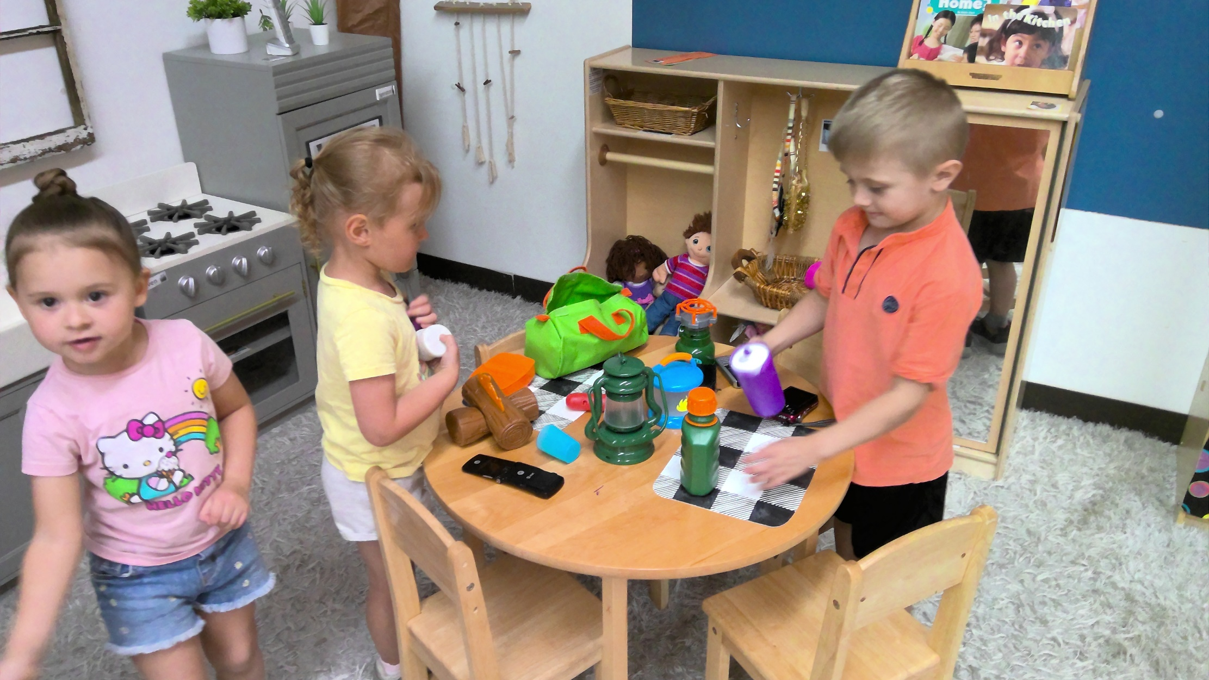
Aubrey, May and Braxton camping.

Slide 3
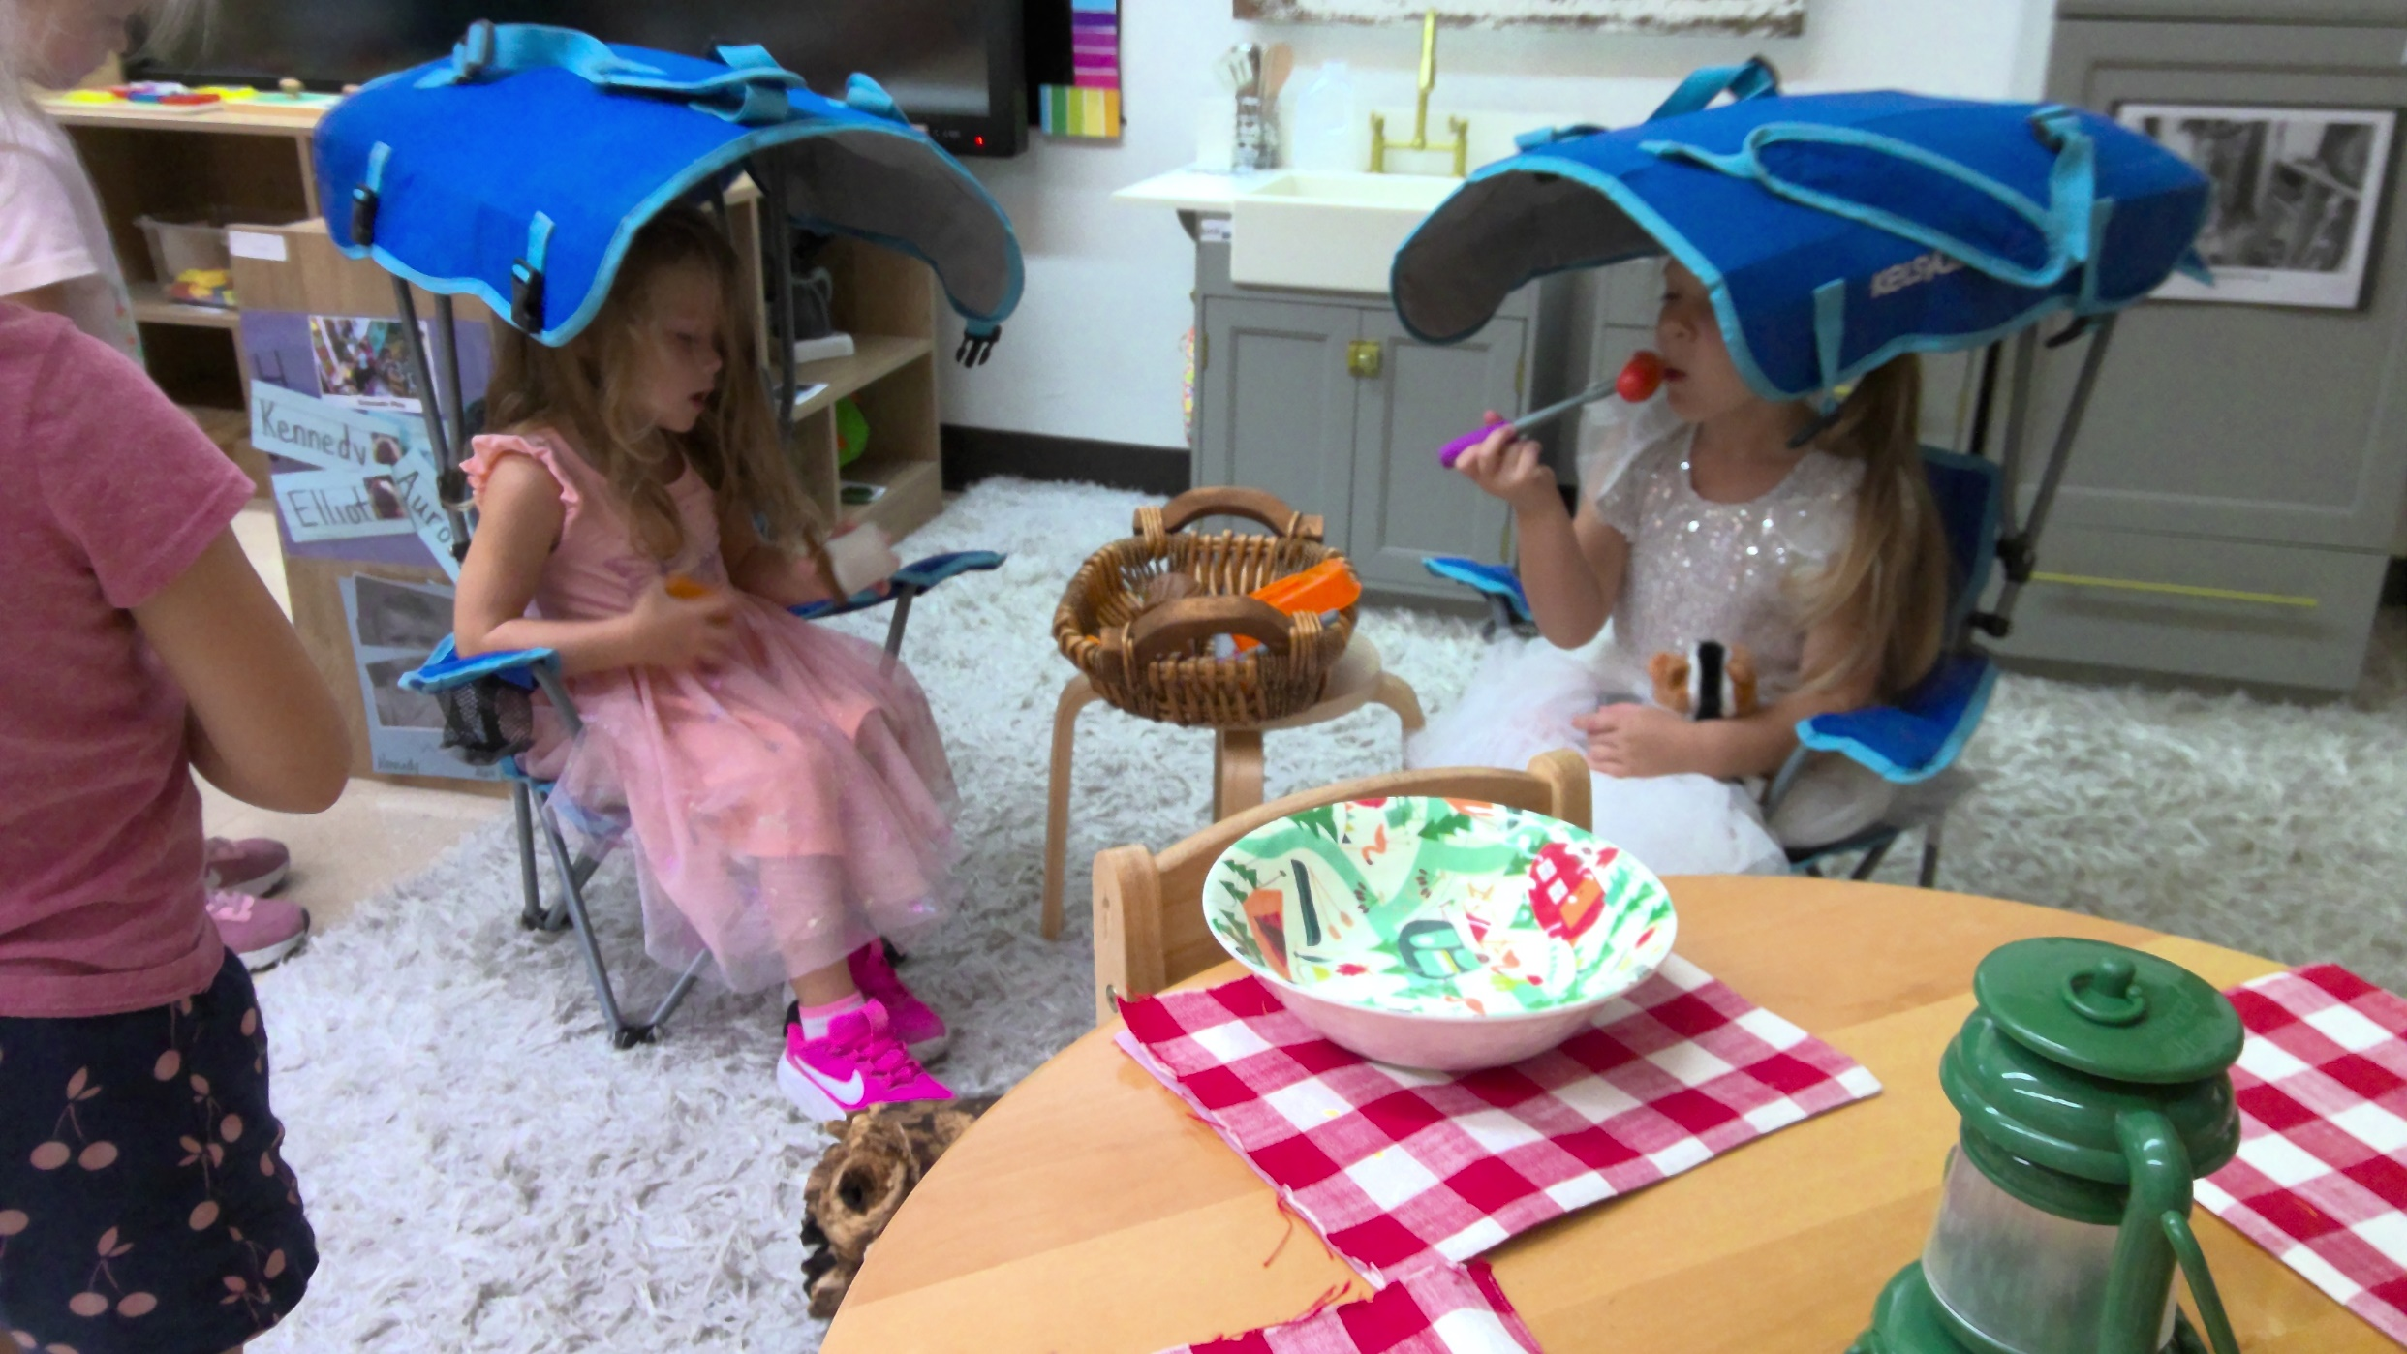
Kennedy and Aurora camping.

Slide 4
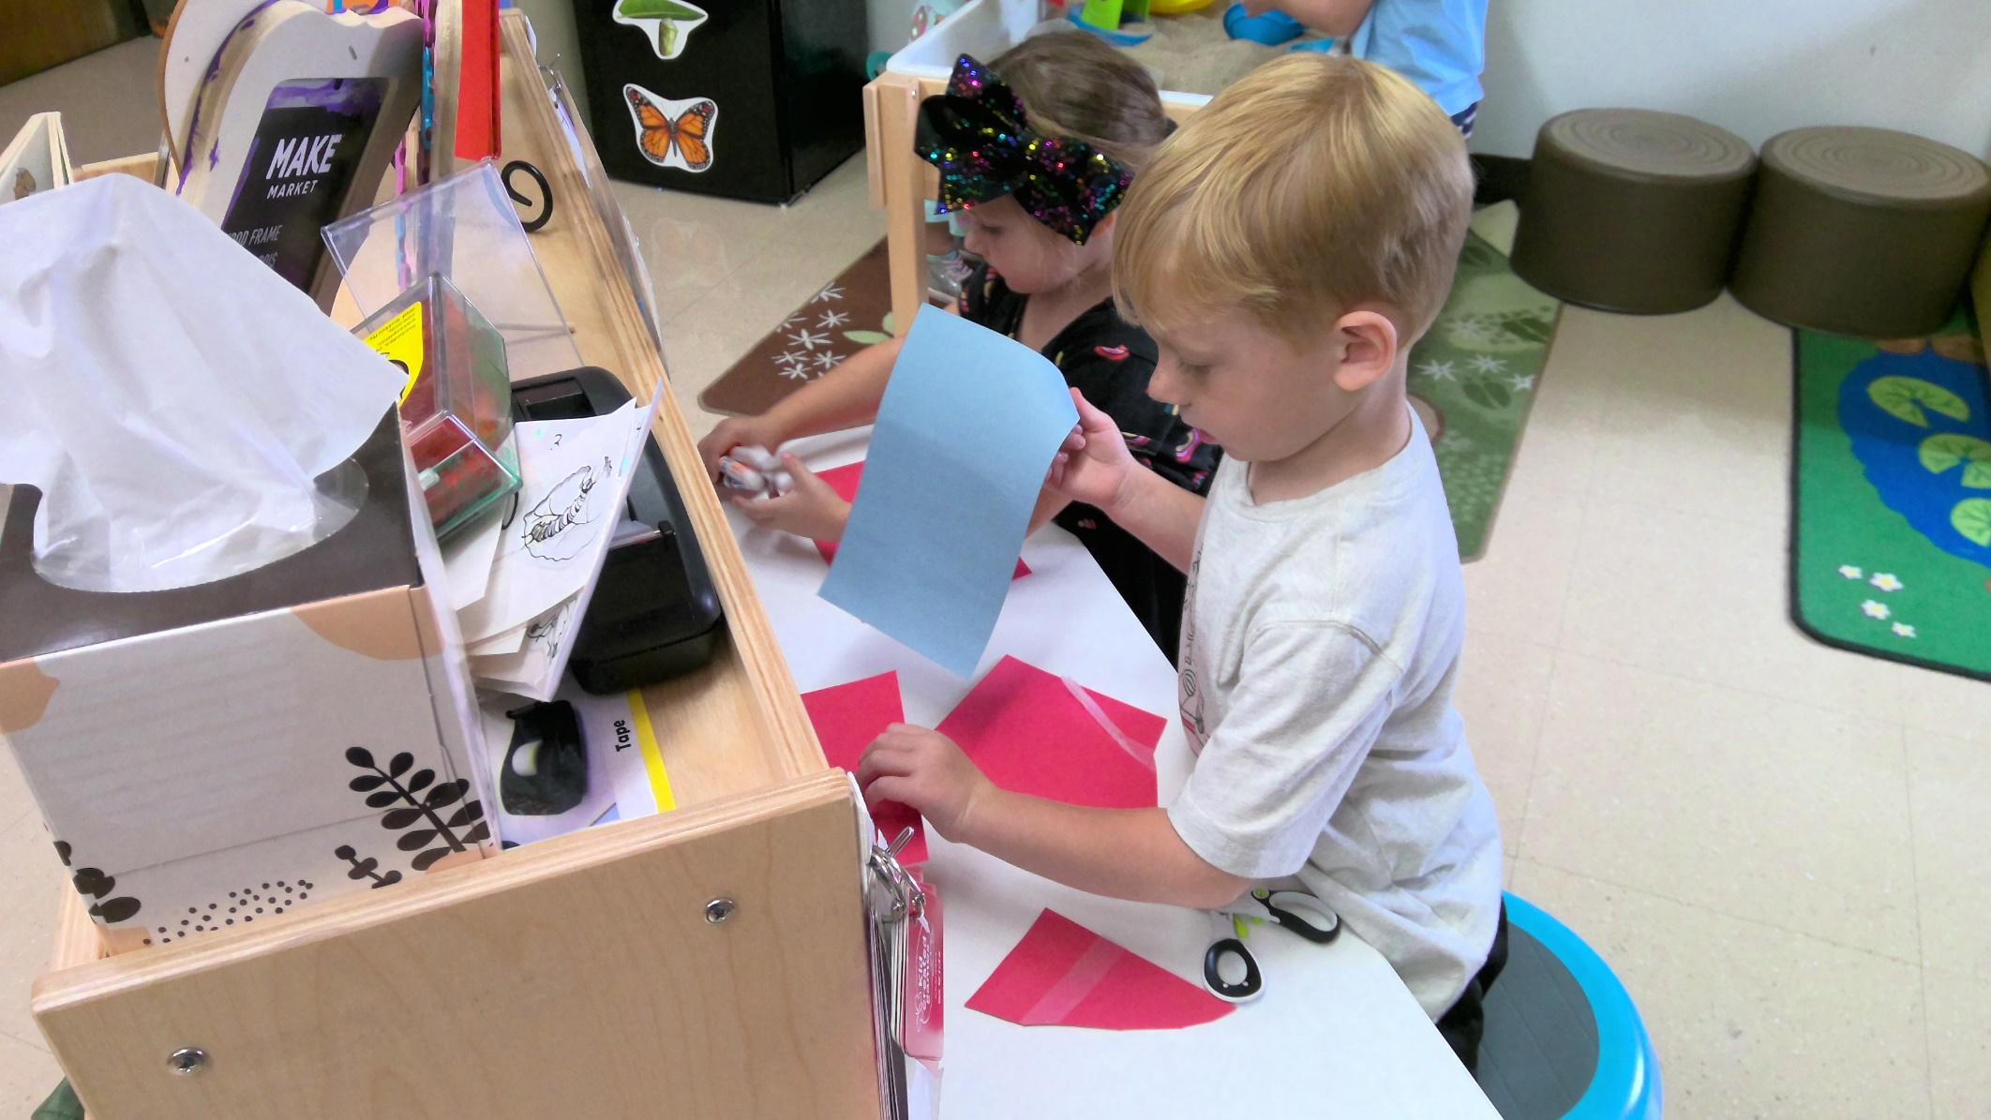
Wyatt and Charlee at Writing Center.

Slide 5
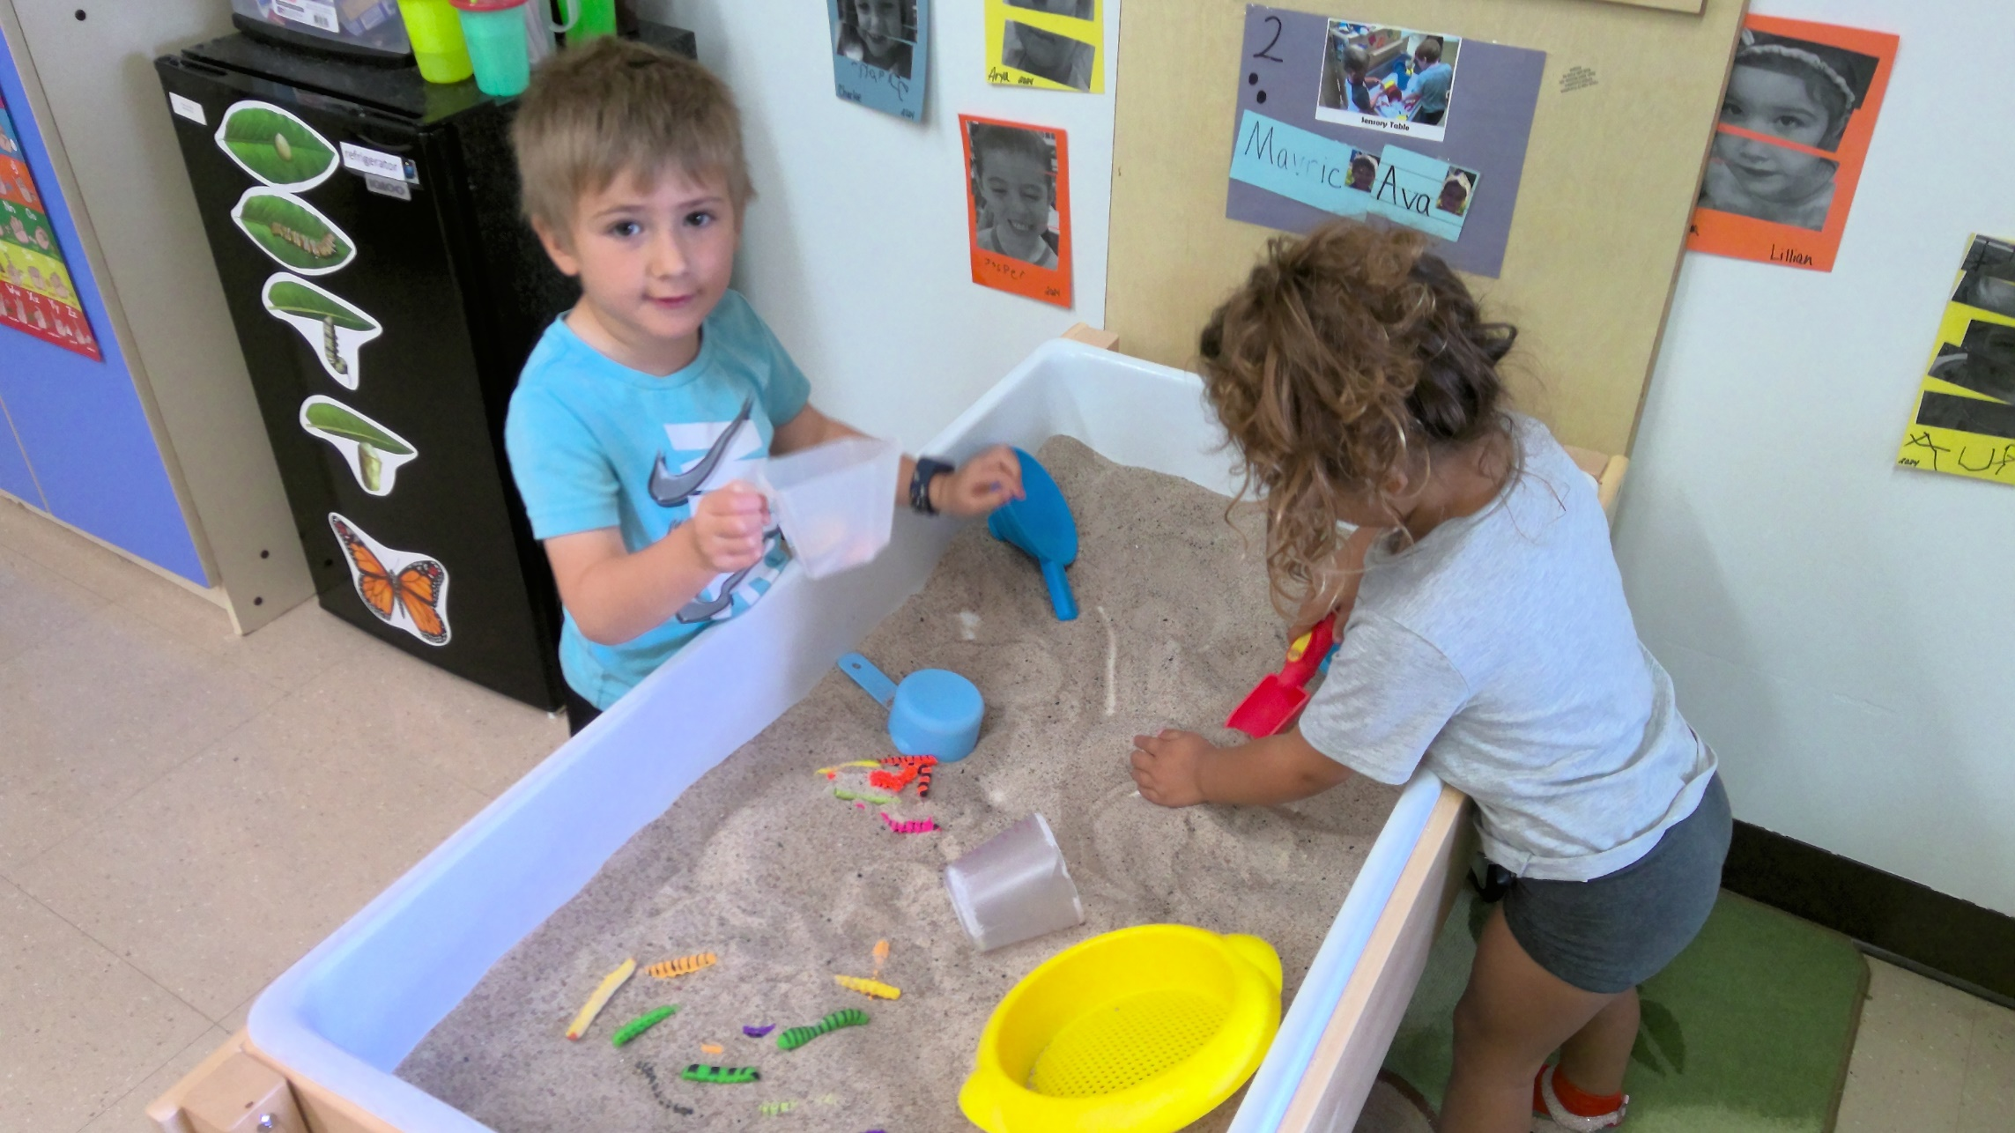
Mavric and Ava finding caterpillars in sand.

Slide 6
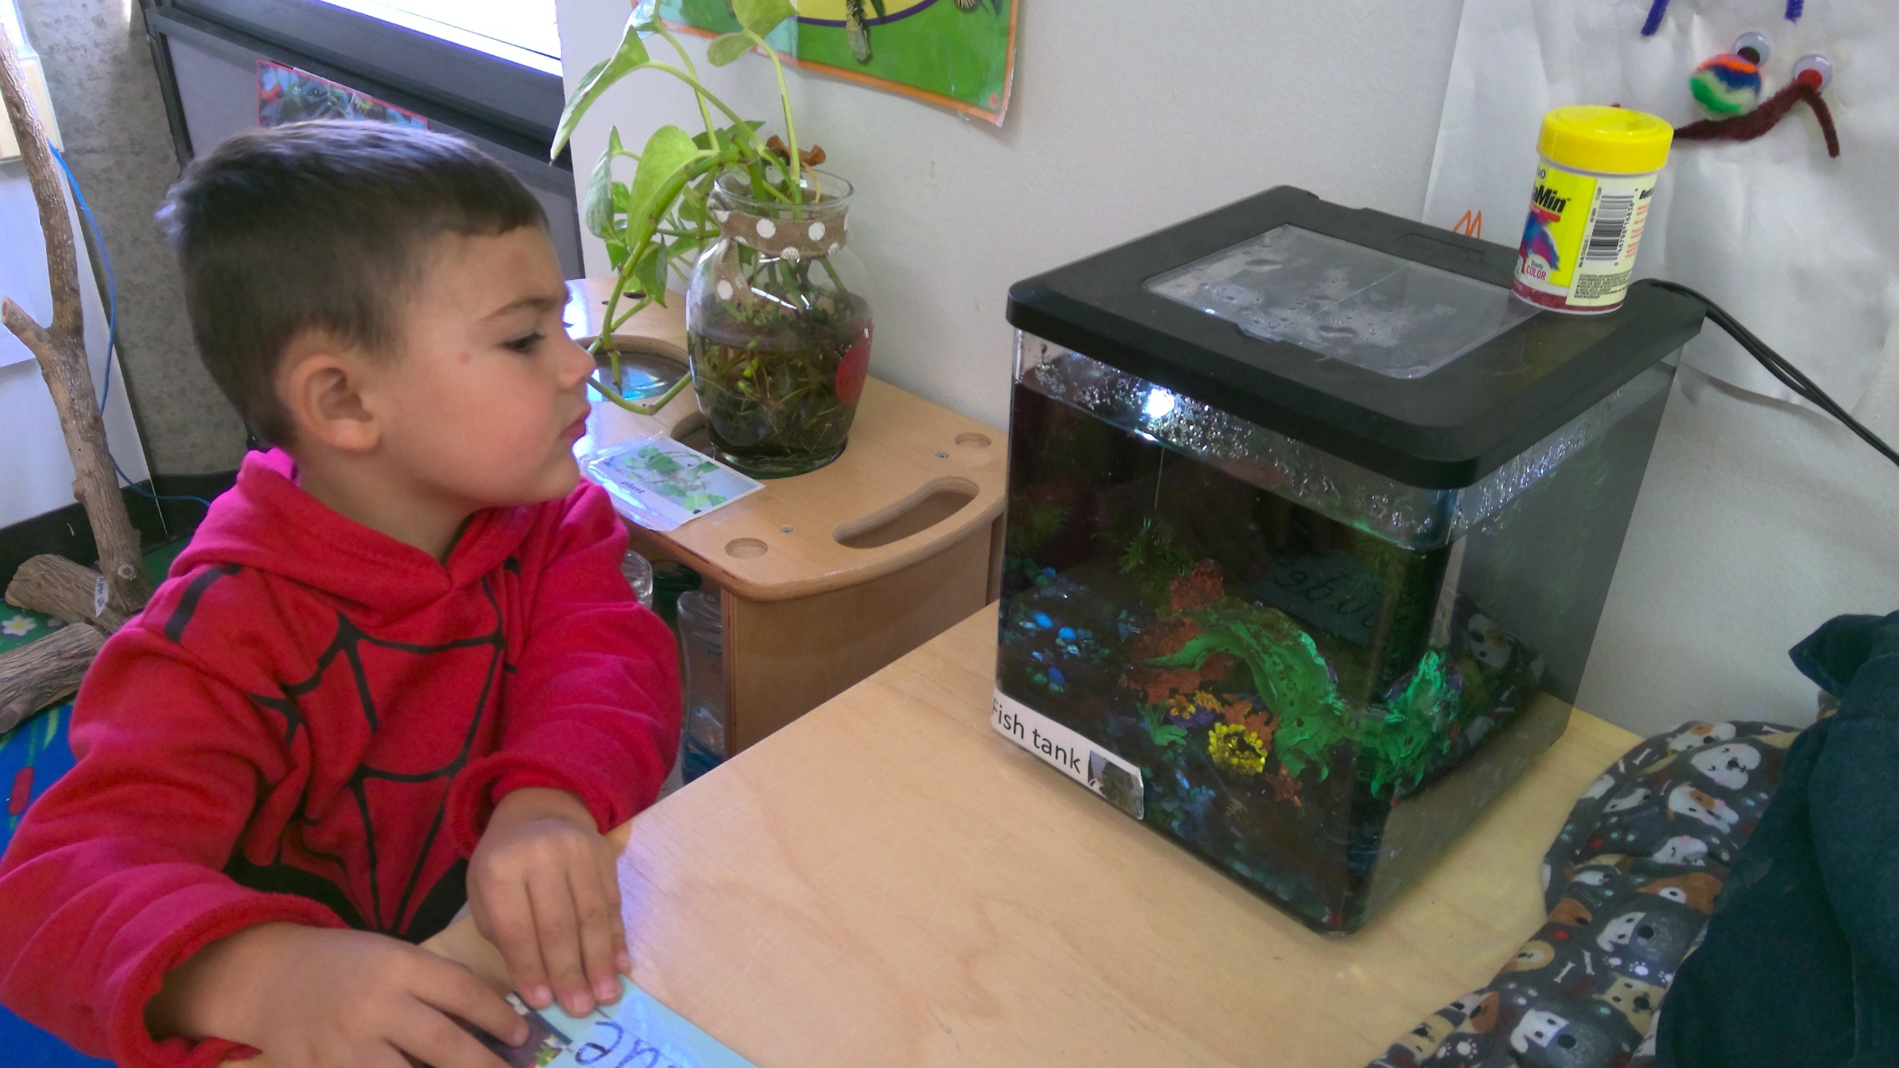
Jude observing our fish.

Slide 7
Aurora feeding her dog. Lyric playing people.

Slide 8
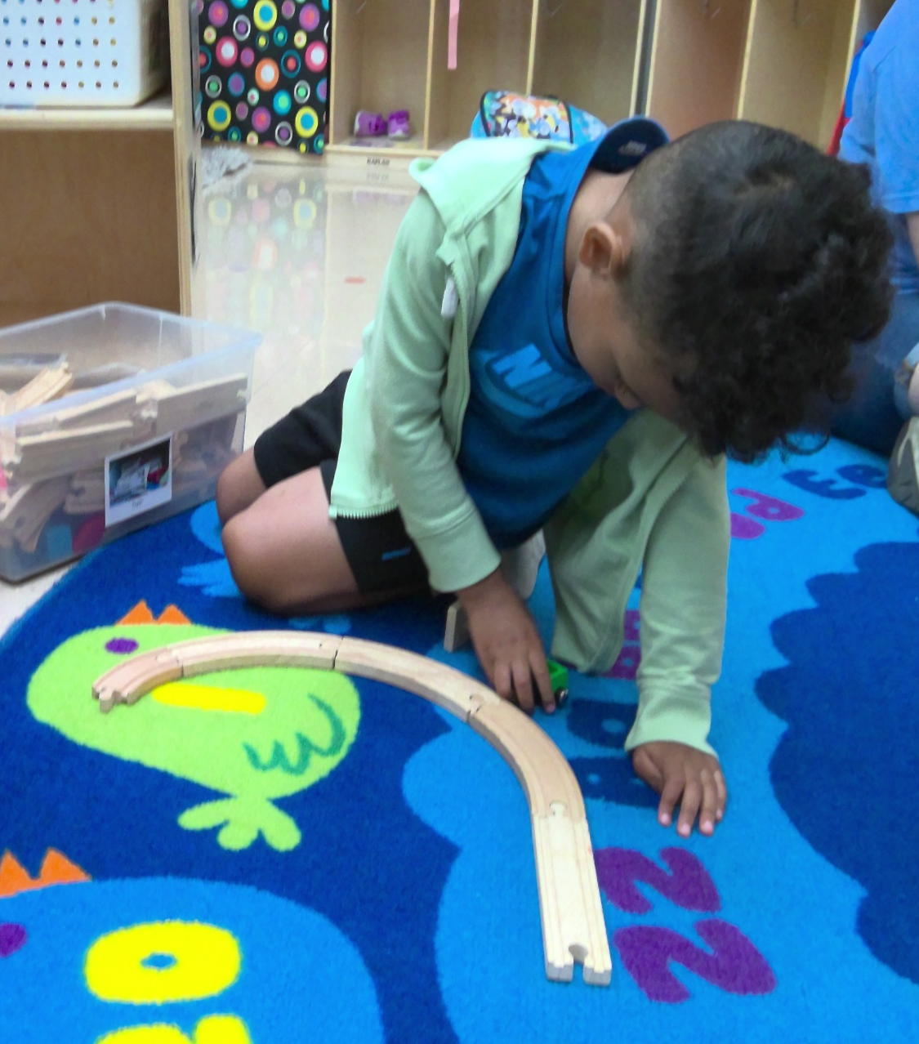
Aziah making a train track. Lillian creating at Art.

Slide 9
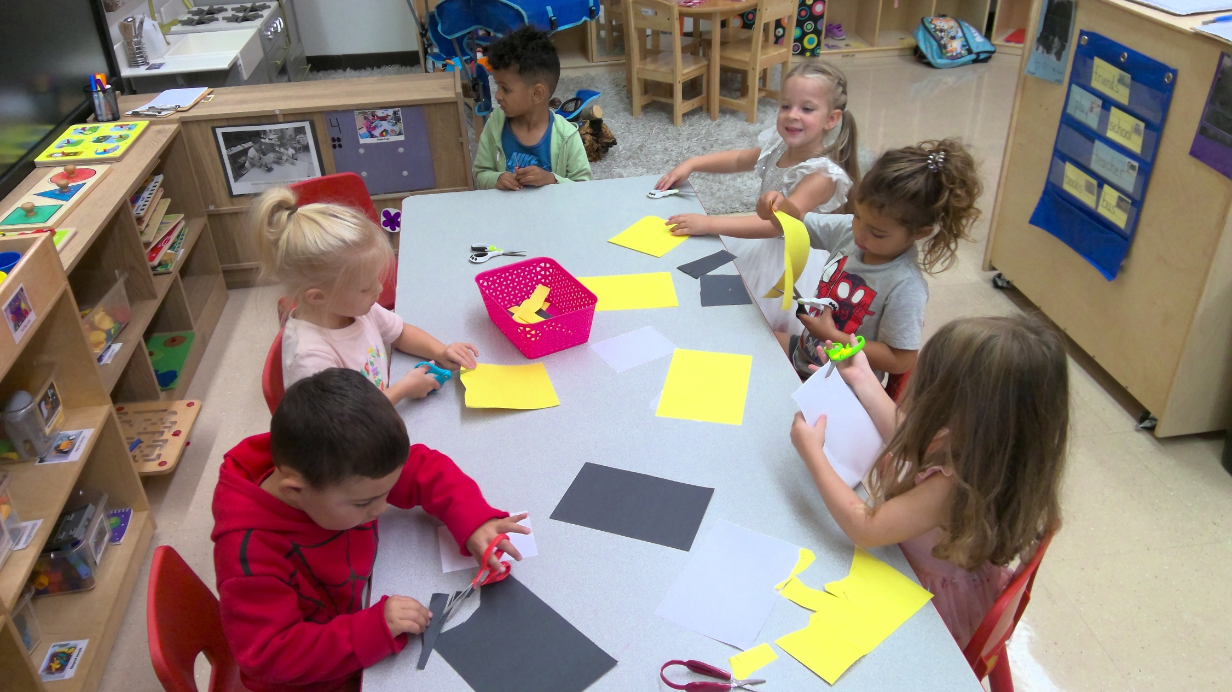
AM friends practicing cutting.

Slide 10
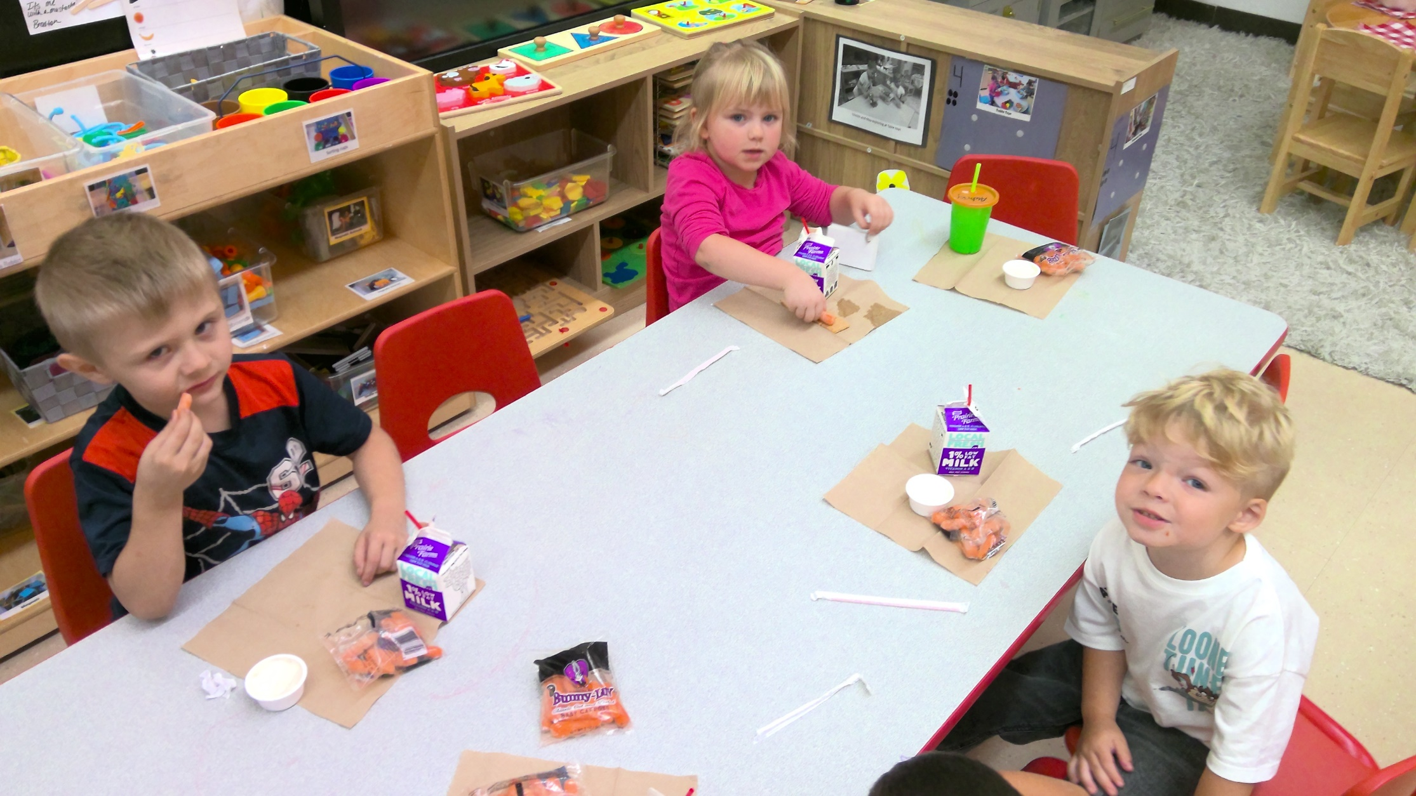
PM friends enjoying snack time.

Slide 11
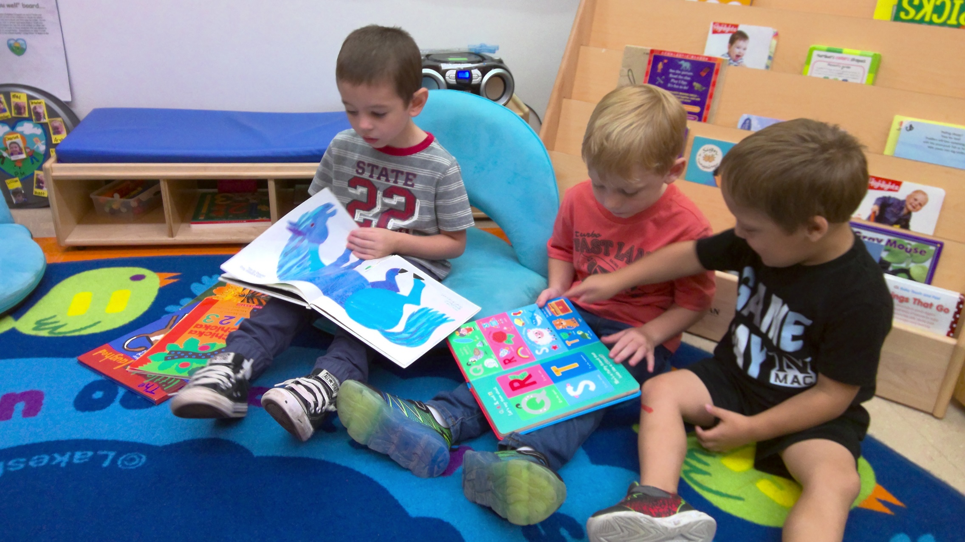
Jasper, Wyatt, and Lincoln reading books.

Slide 12
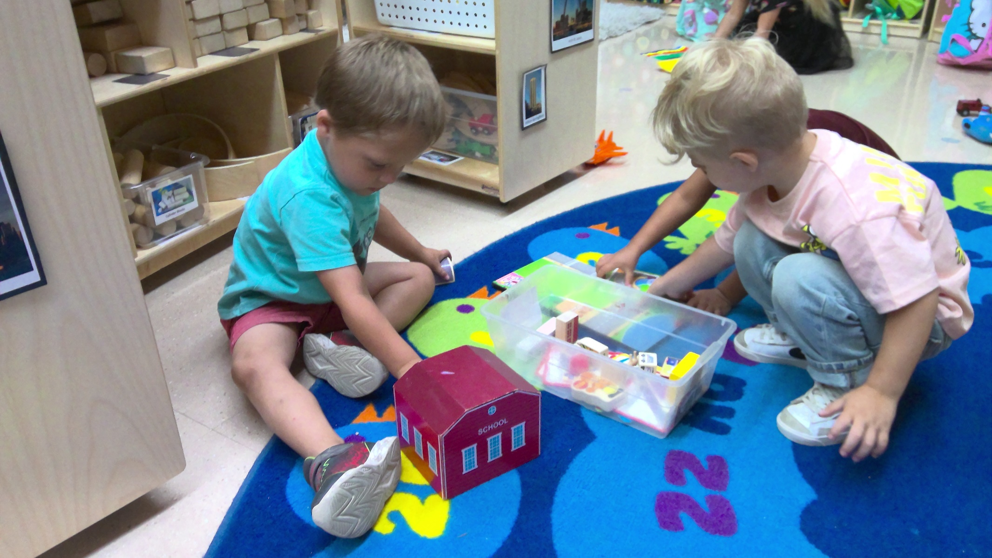
Keenan and Lincoln at Block area.

Slide 13
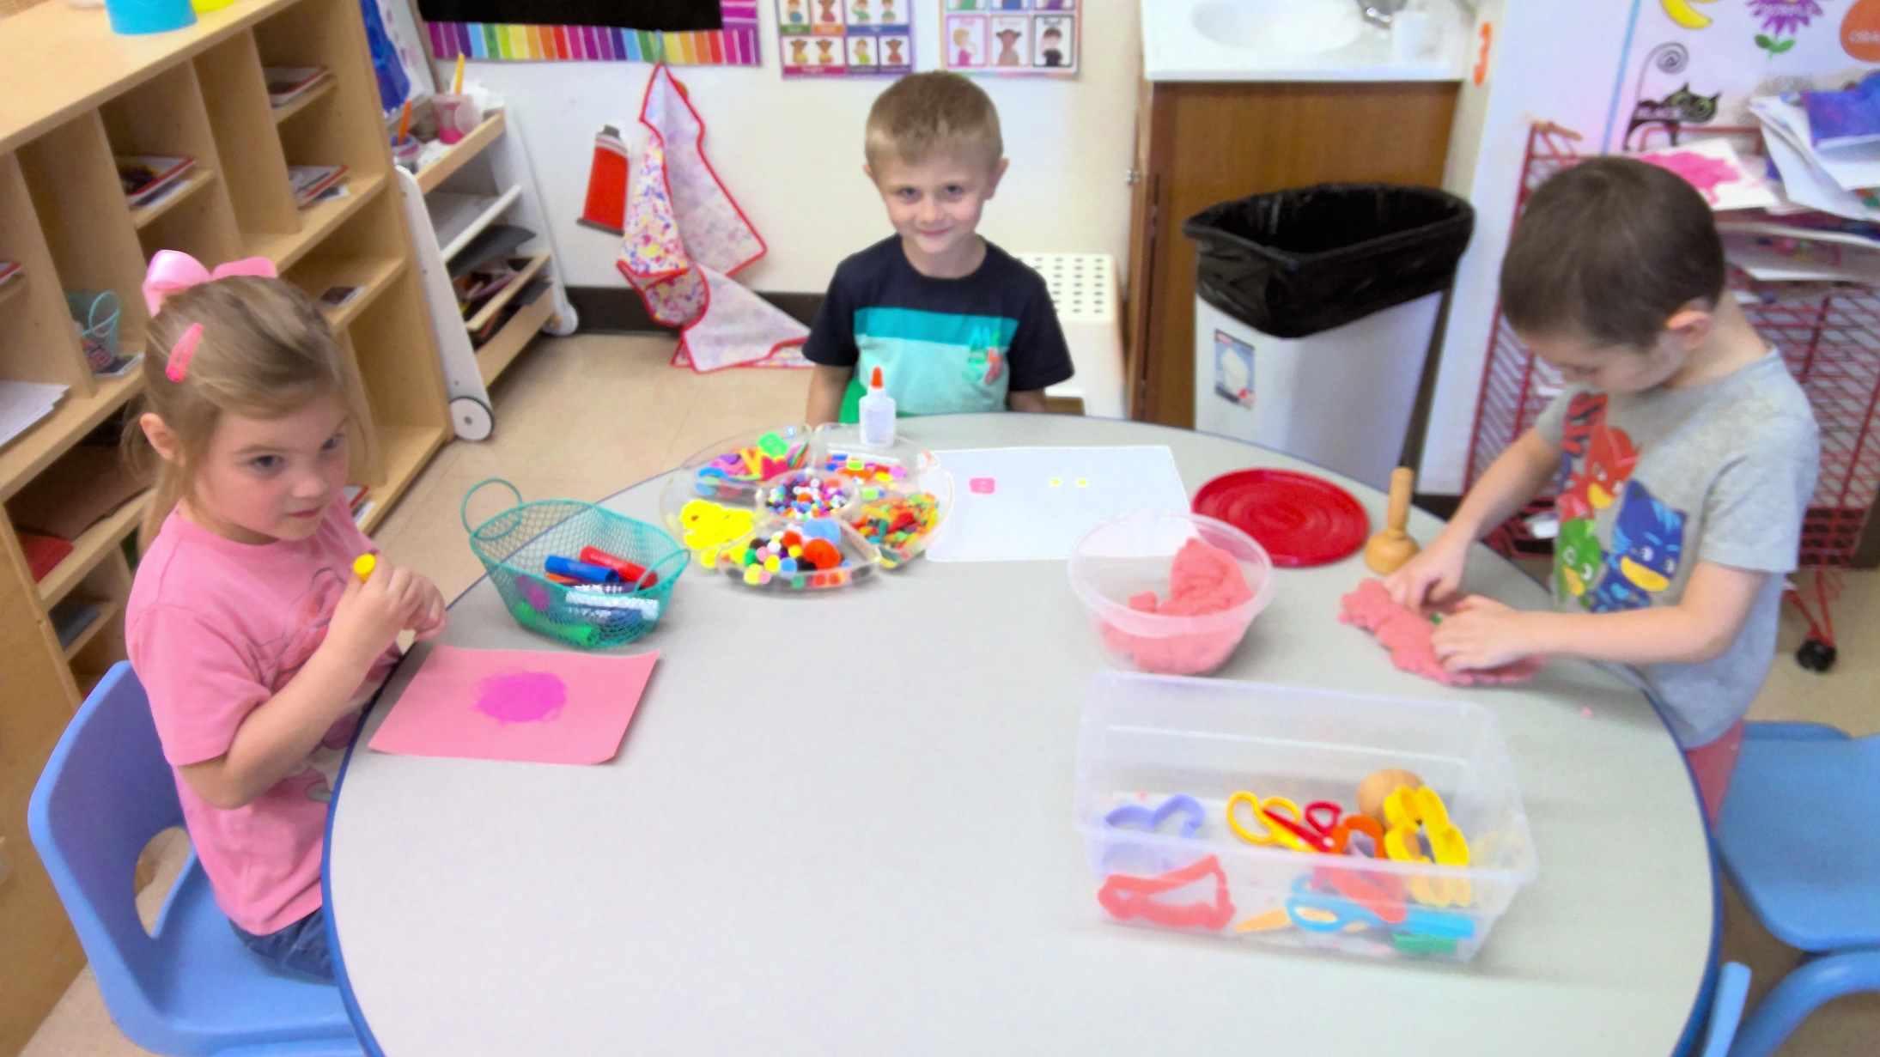
Lillian, Braxton, and Jasper creating at Art.

Slide 14
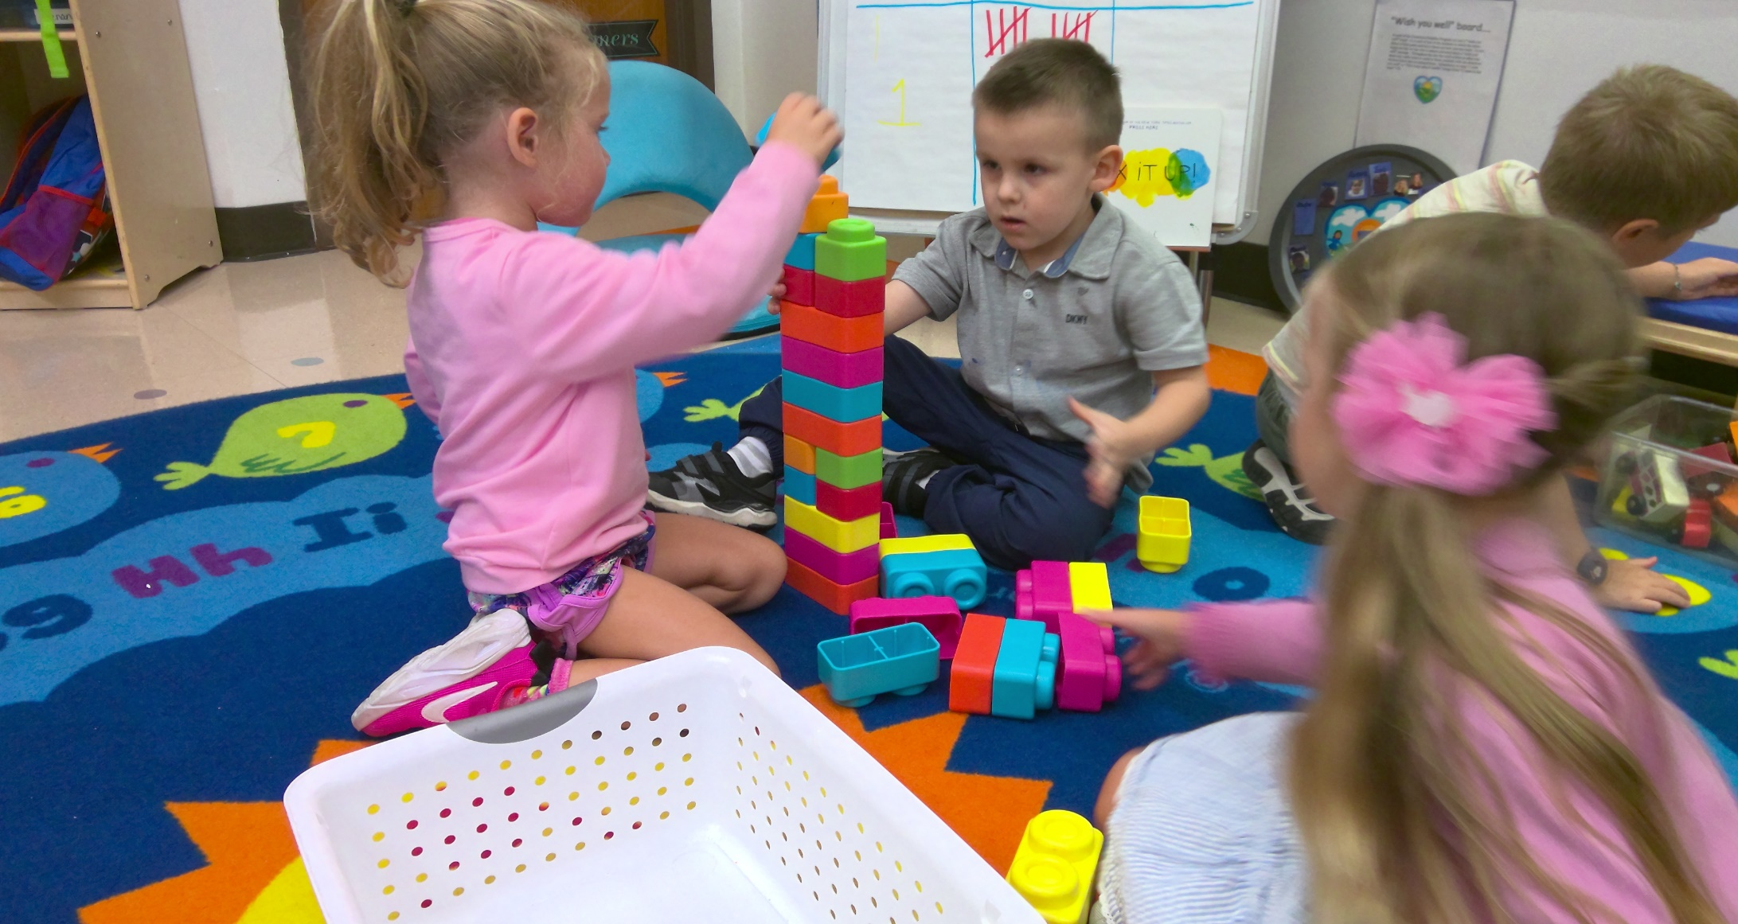
Kennedy, Gatlian, and Aurora working together in blocks.

Slide 15
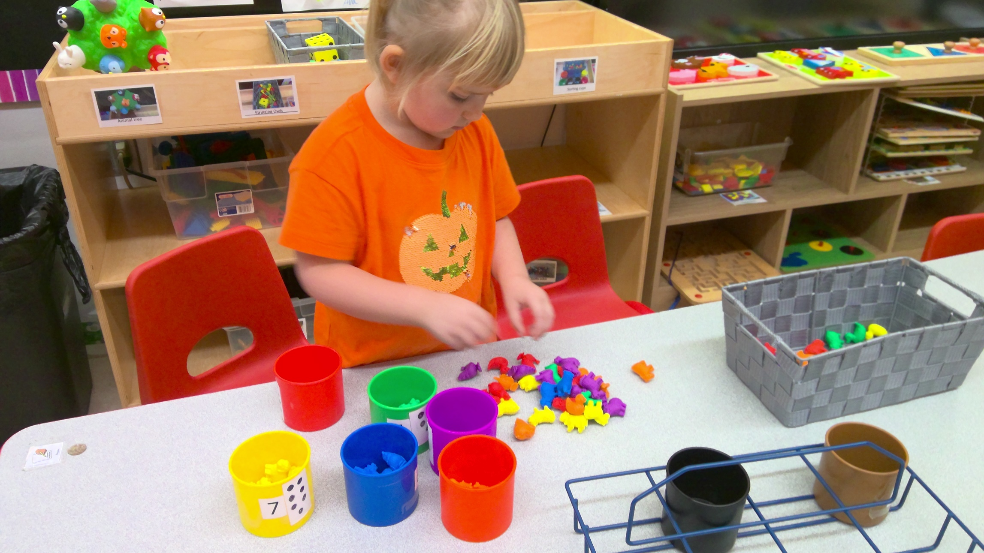
Arya sorting animals.

Slide 16
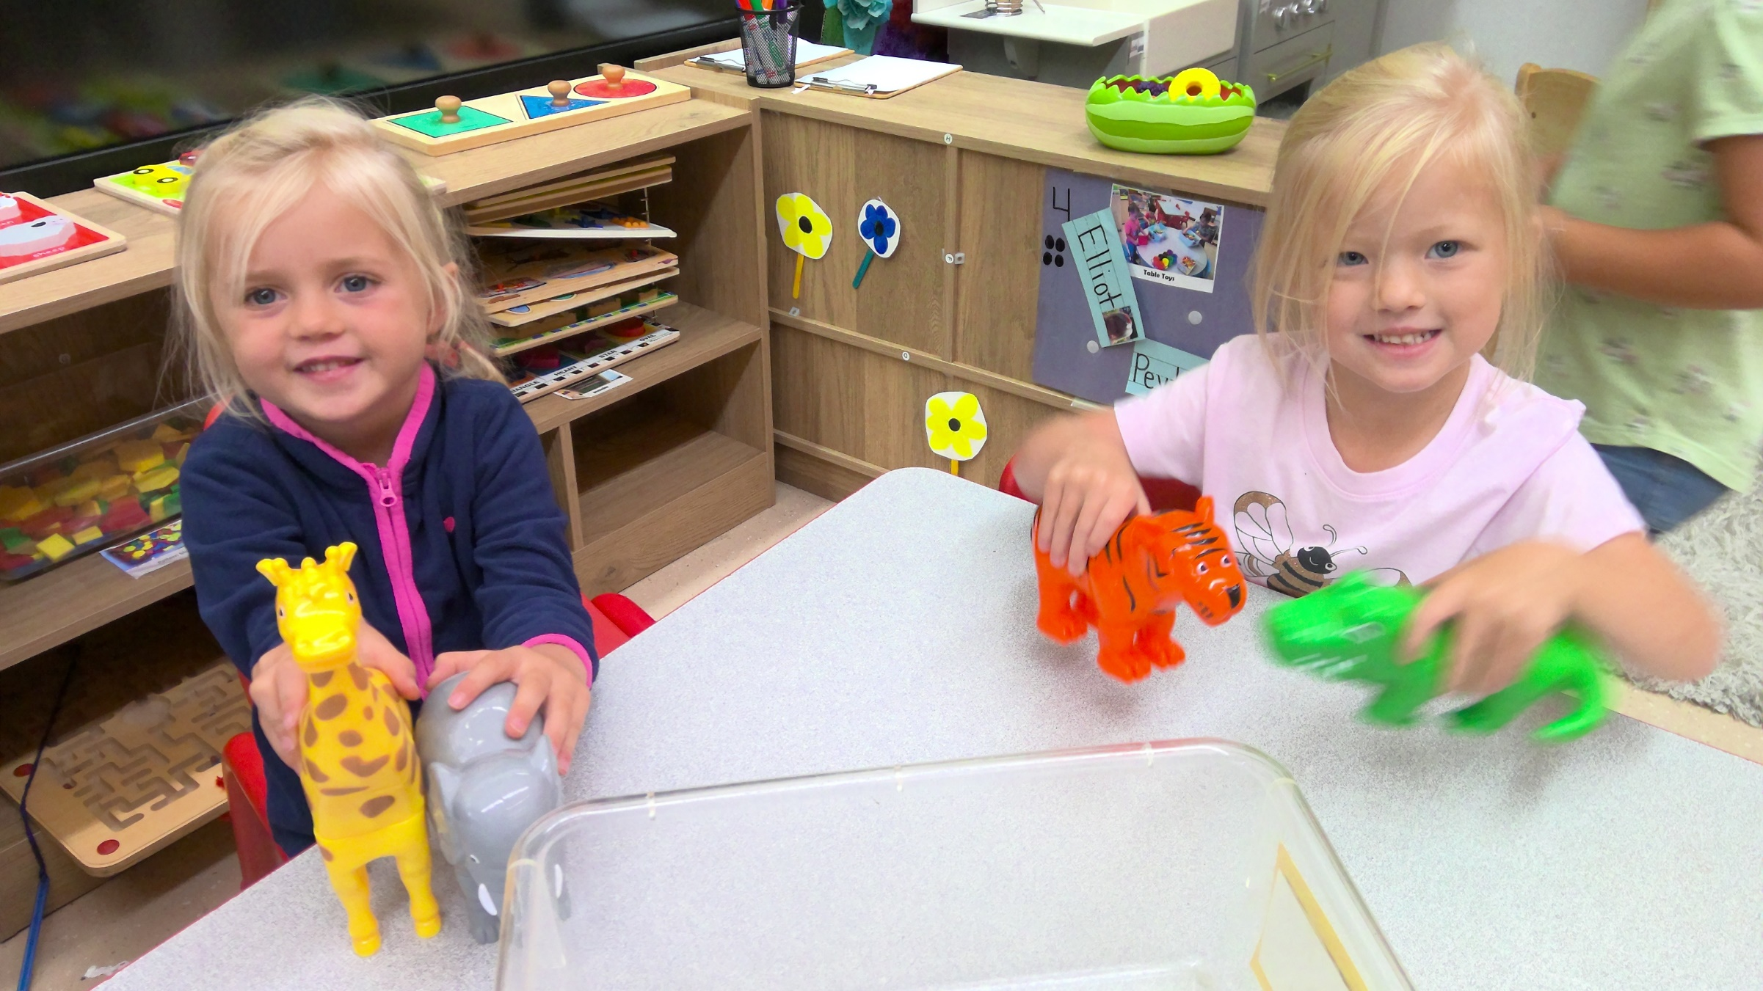
Elliot and Peyton creating magnet animals.

Slide 17
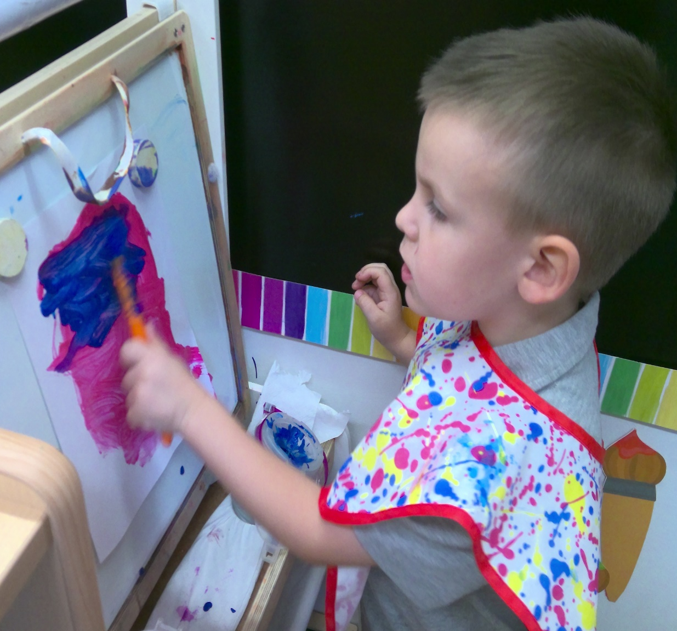
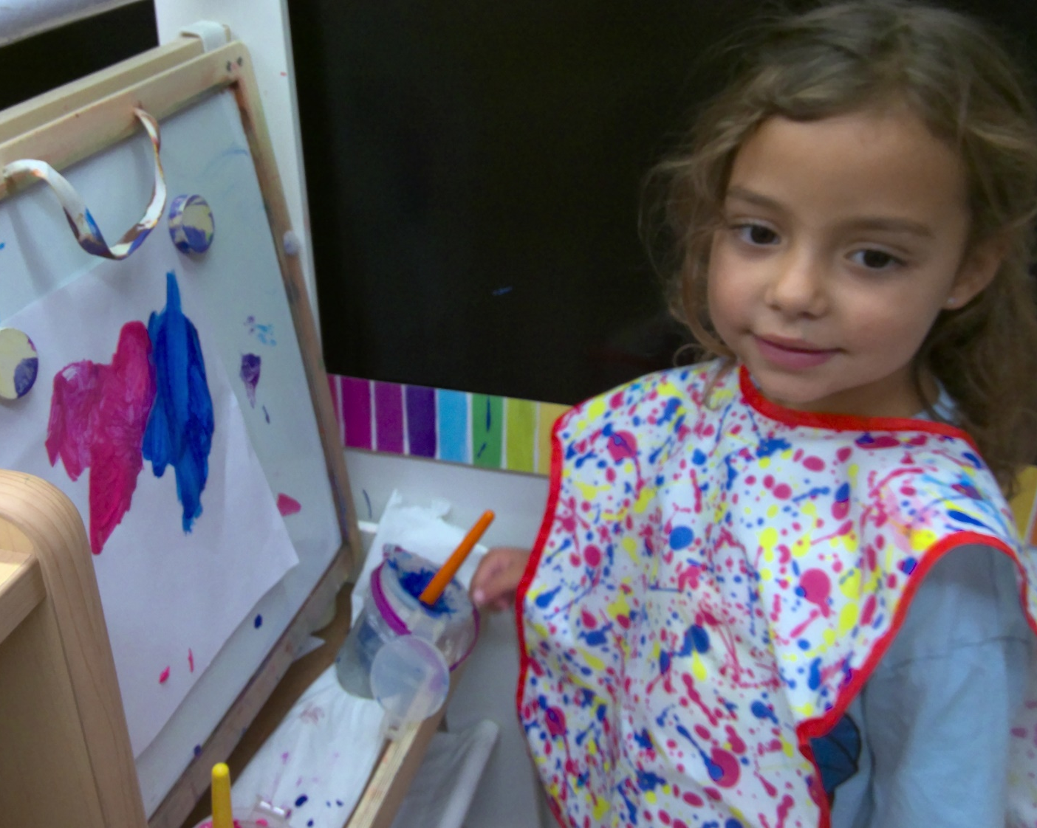
Gatlian and Ava creating at Painting.

Slide 18
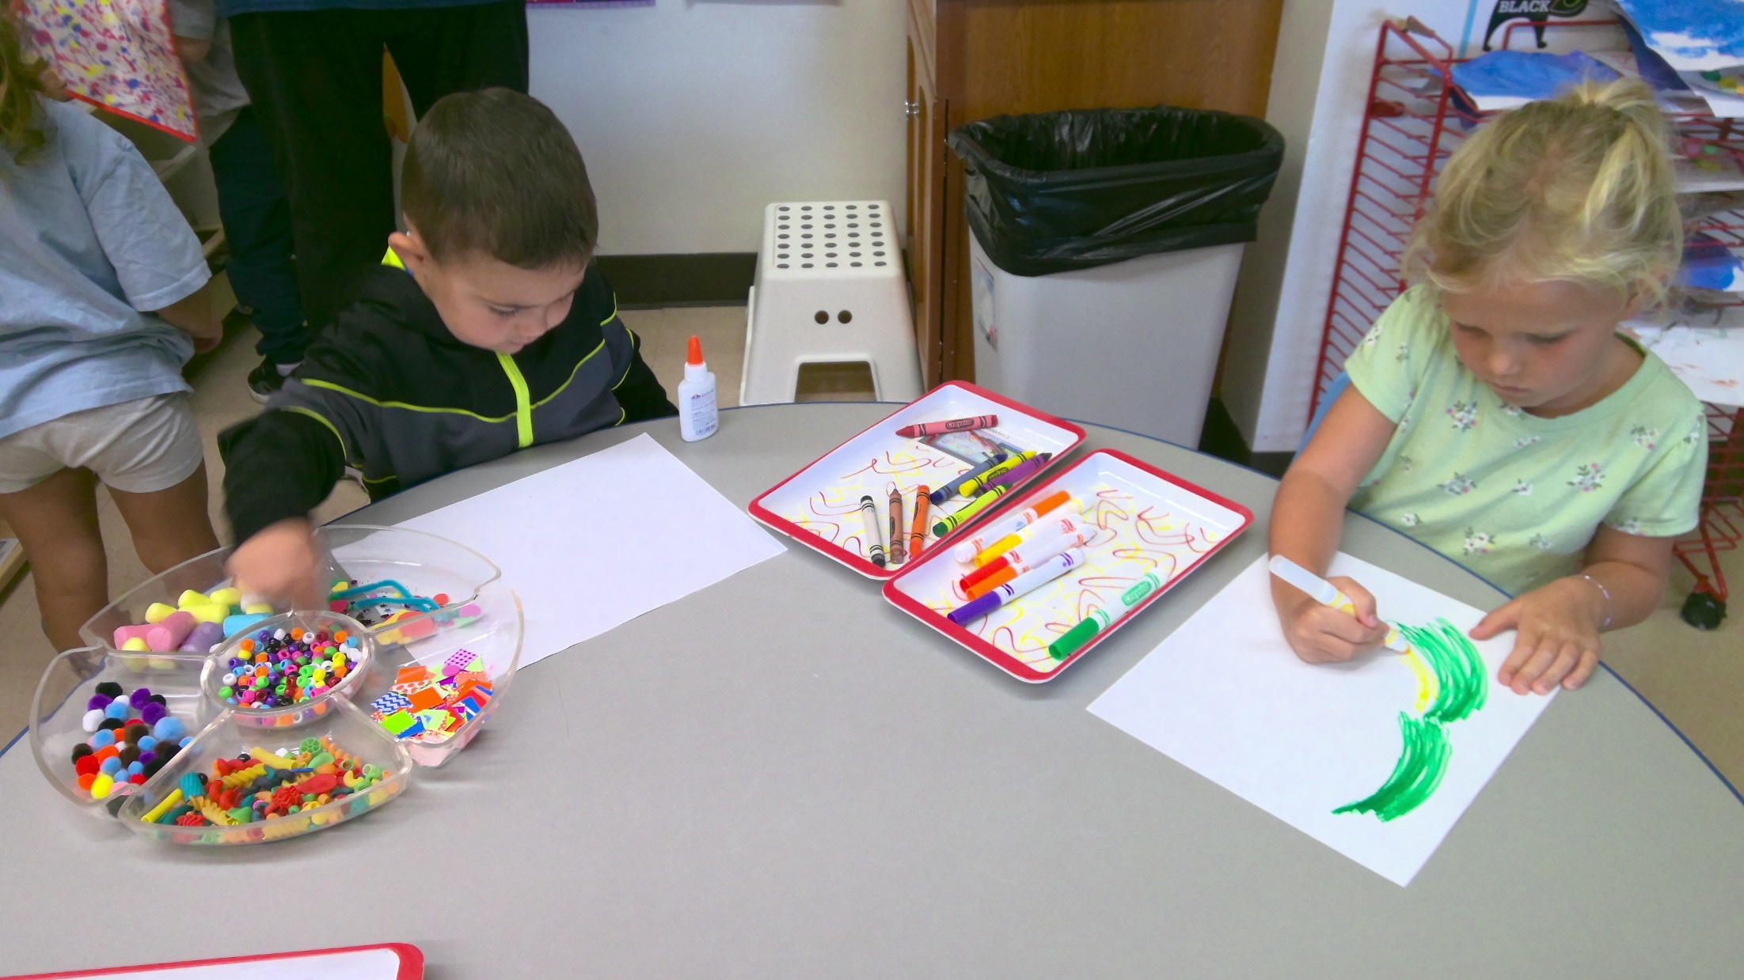
Jude and Ivy creating in Art area.

Slide 19
Aurora playing dress up. Mavric playing with cars.

Slide 20
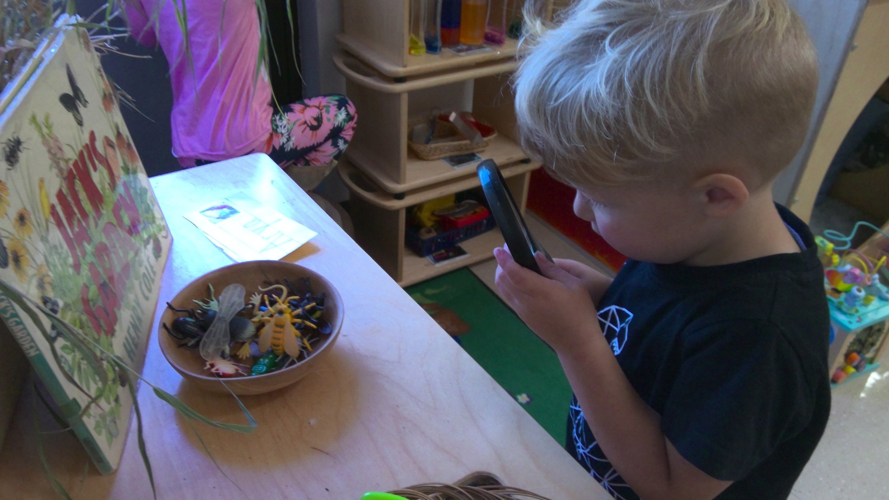
Keenan observing with a magnifying glass.

Slide 21
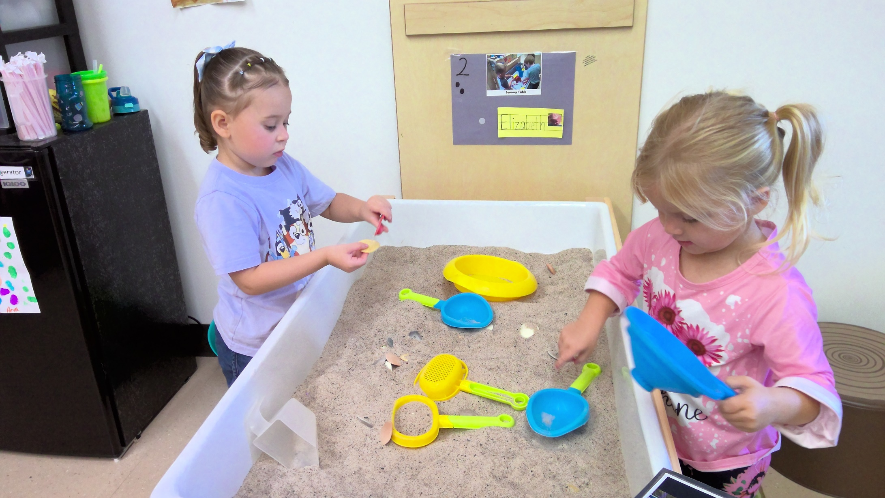
Aubrey and Elizabeth finding rocks in Sand.

Slide 22
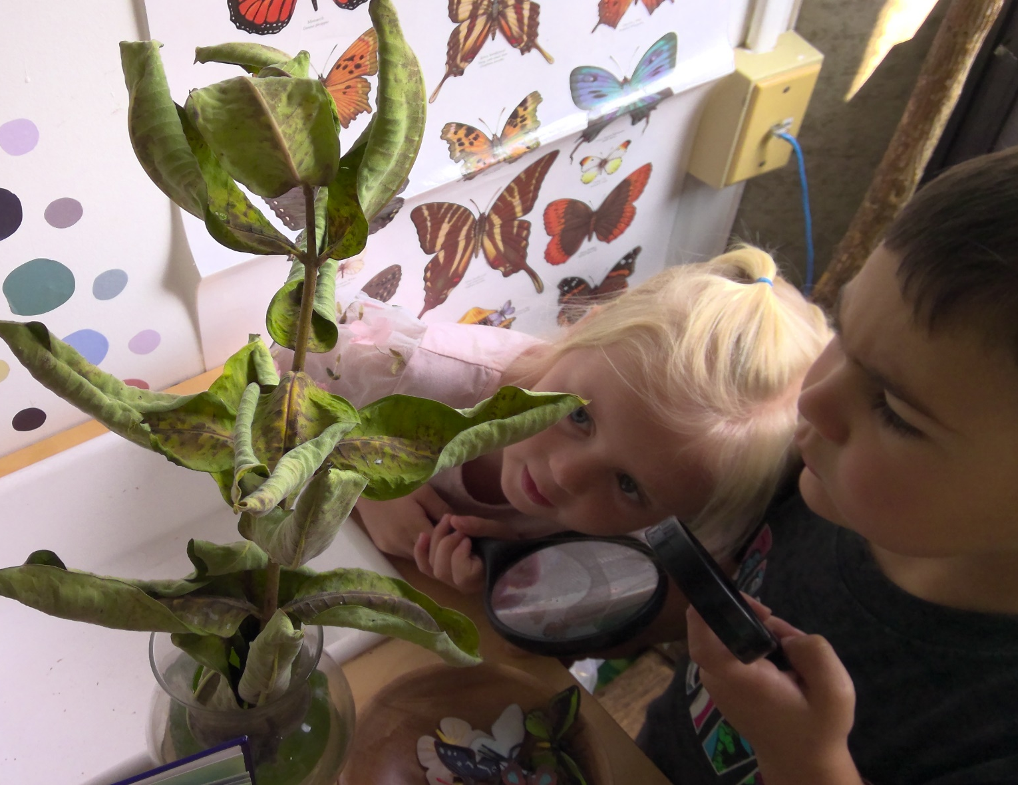
Aurora in Science. Elliot and Jude searching for caterpillars.

Slide 23
Lyric sorting shapes. Delilah scooping sand.

Slide 24
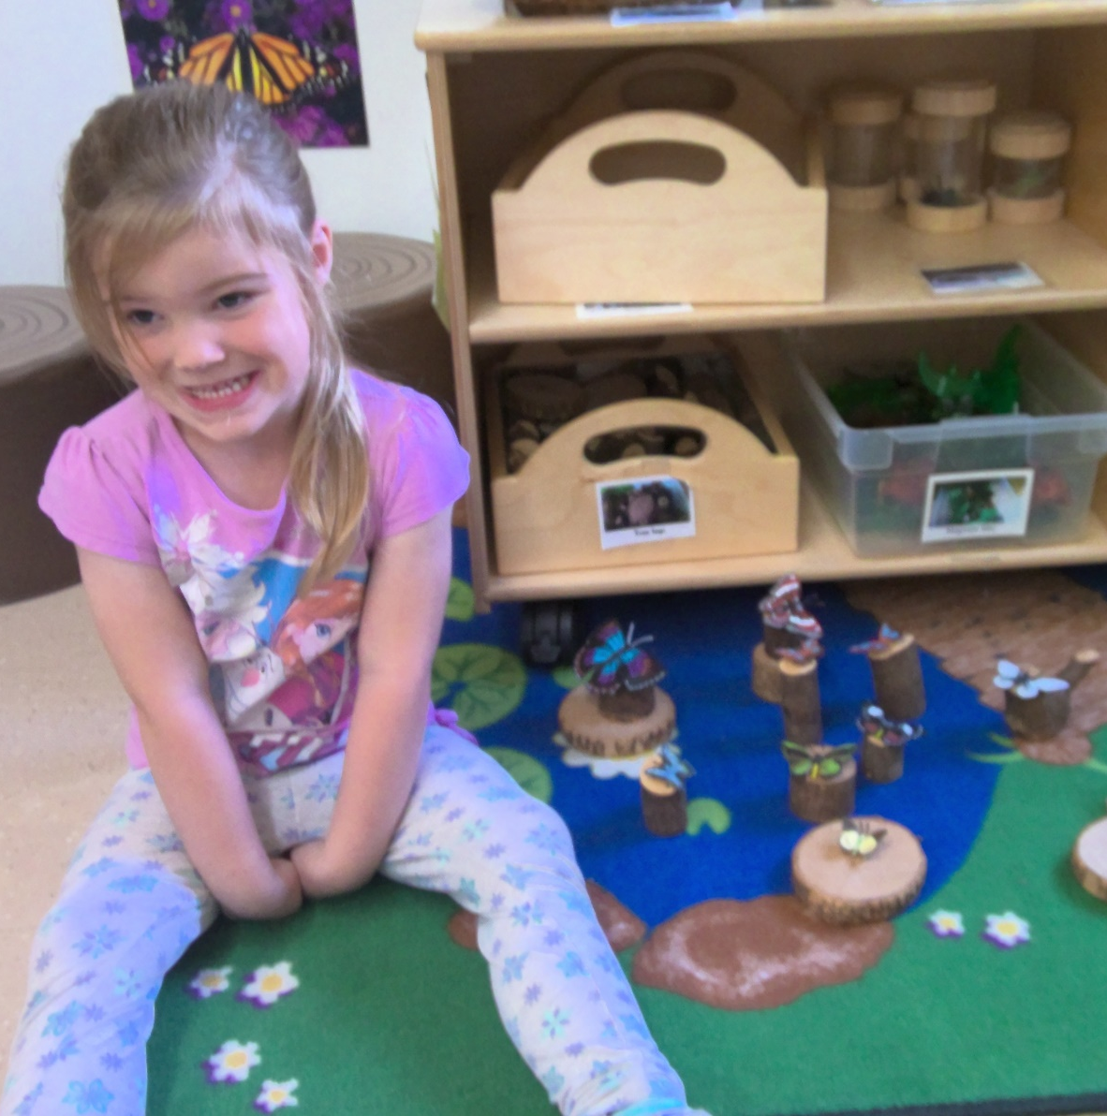
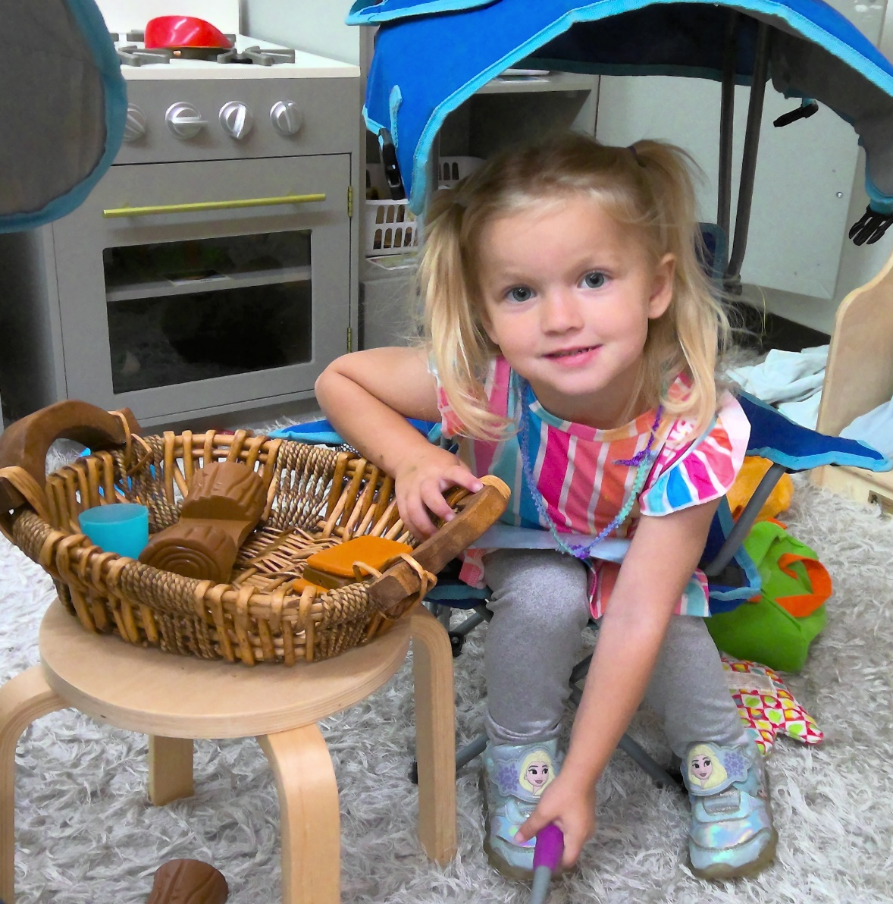
Lillian with her butterflies. Elizabeth at camping.

Slide 25
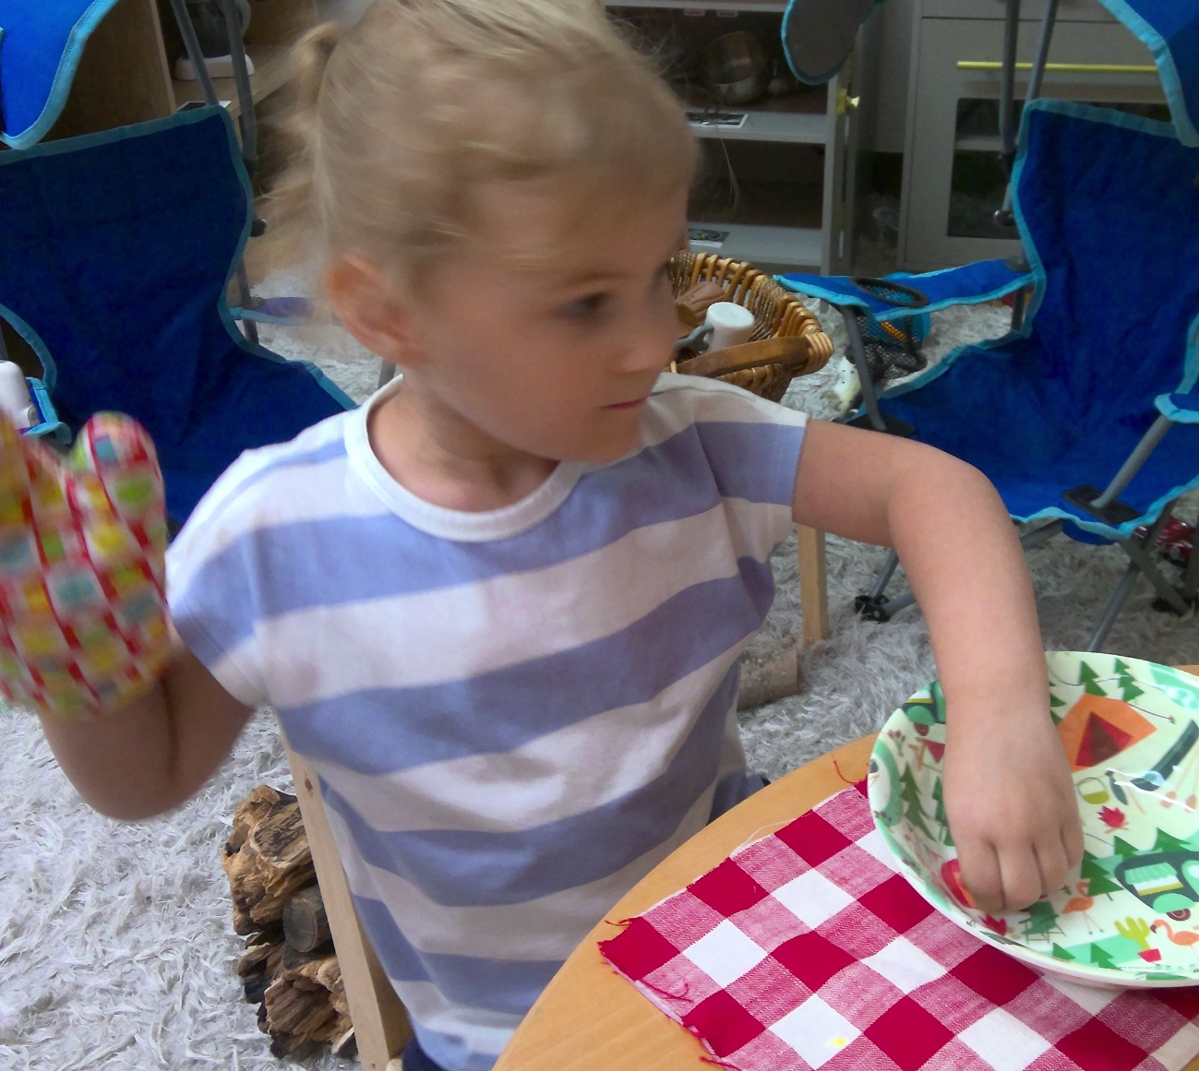
May camping. Charlee making cookies.

Slide 26
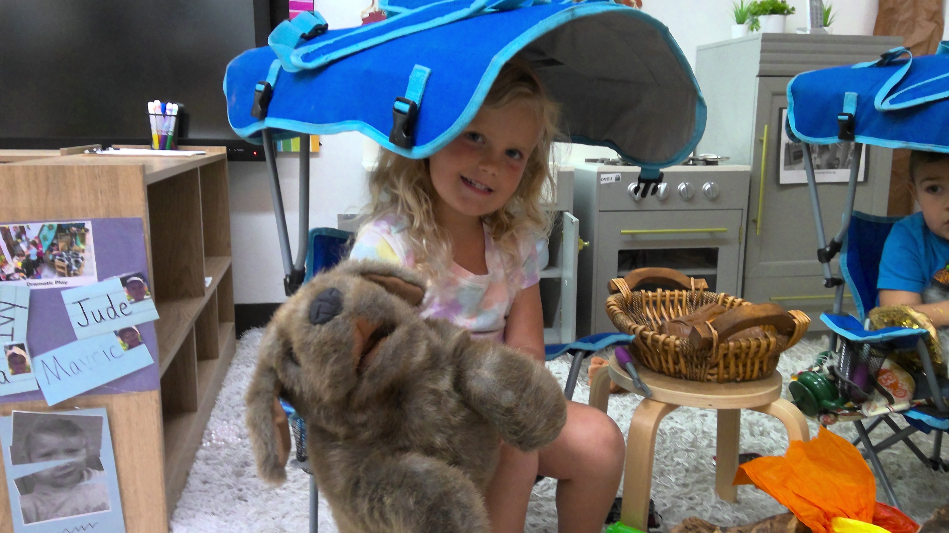
Ivy with her dog camping.

Slide 27
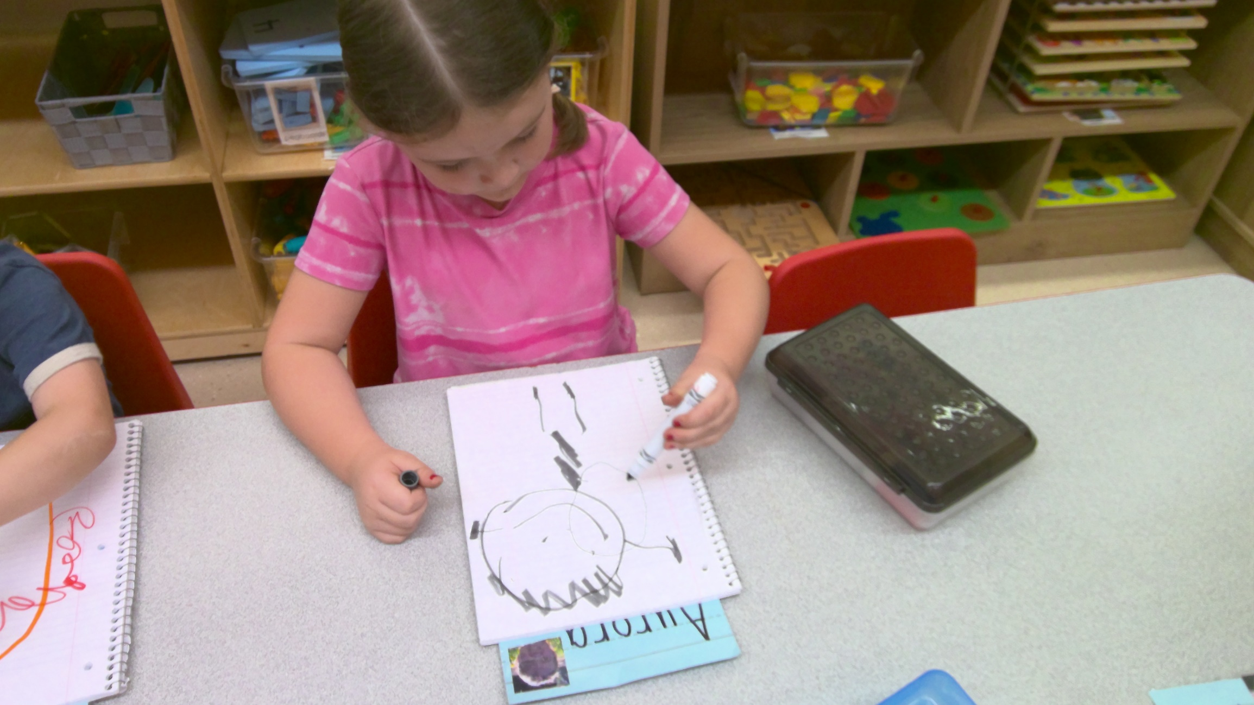
Aurora Miller working in her journal.

Slide 28
Thank you so much for sharing your children with us!

